Slide 1
Policy and Governance
Regulatory Frameworks
Security Standards
Interoperability and Standards
Governance Structures
Ethical Considerations

Slide 2
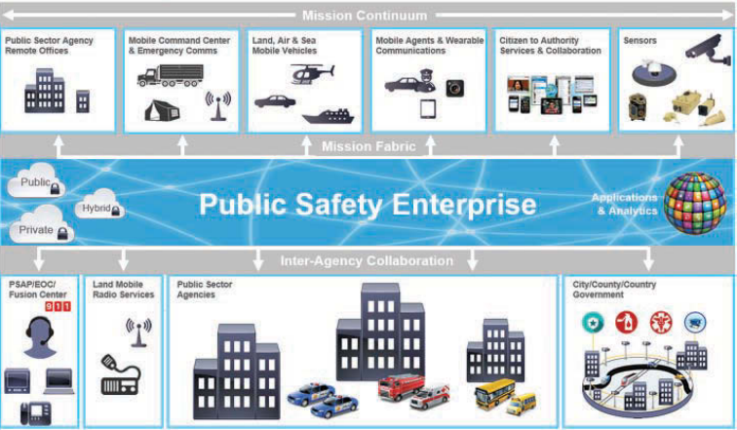
IoT Blueprint For Public Safety

